Slide 1
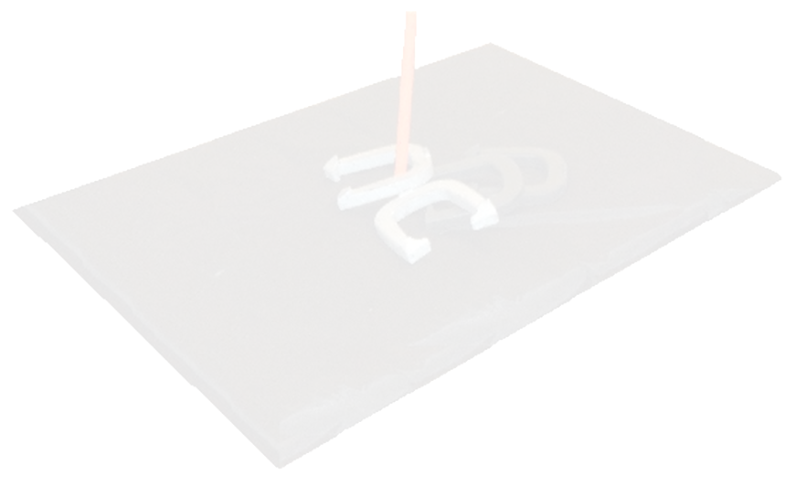
Kuchcinski Safe Pitch
the new era of horseshoes

Slide 2
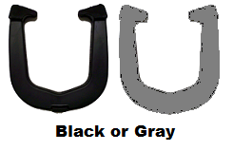
Safe Horseshoes
Rubber Composite.
Like Tennis Shoes on Gym Floor.
Patented Design.

Slide 3
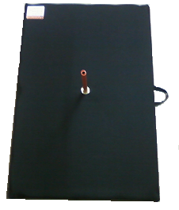
Landing Pit
Durable.
Easy storage with secure, collapsible stake.
Easy to carry.
30” x 44” landing area.

Slide 4
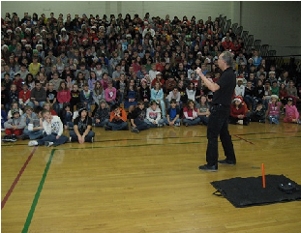
Training
Three time world horseshoe pitching champion, Dan Kuchcinski.

Slide 5
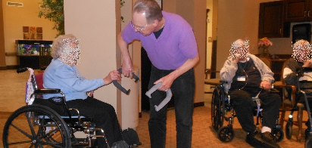
Rules
Traditional rules enhanced.
All shoes landing on pit score.
No eliminations.
Pitching distances 5 to 30 feet for ages and handicap.

Slide 6
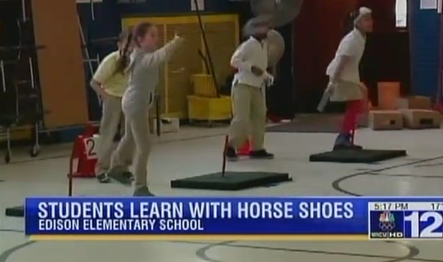
Tournaments

Slide 7
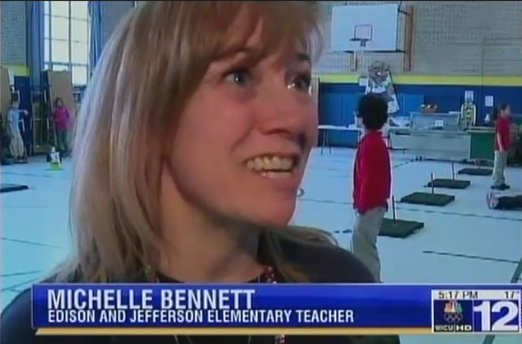
Tournaments

Slide 8
Our Website
www.safehorseshoes.com
Testimonies.
Organizations using Safe Pitch.
Tournaments.
Video of Dan on Johnny Carson Show.

Slide 9
New Horseshoe Pitching Era
Portable Indoor/Outdoor Landing Court Systems!
A Revolutionary System of a Lifetime!
Designed for all Ages and Capabilities!
Promotes Success and Safety!
Therapeutic and Fun!
Physical Education and Health Classes!
Wheel Chair Accessible!
Casual or Competitive!
Build Focus Balance and Strength!
How to become a Champion!

